Slide 1
AlignTac
Aligning Real Tactile Images with Simulated
Geometry for Label-Efficient Contact Learning
RoboSoft 2027
Notes:
8

Slide 2
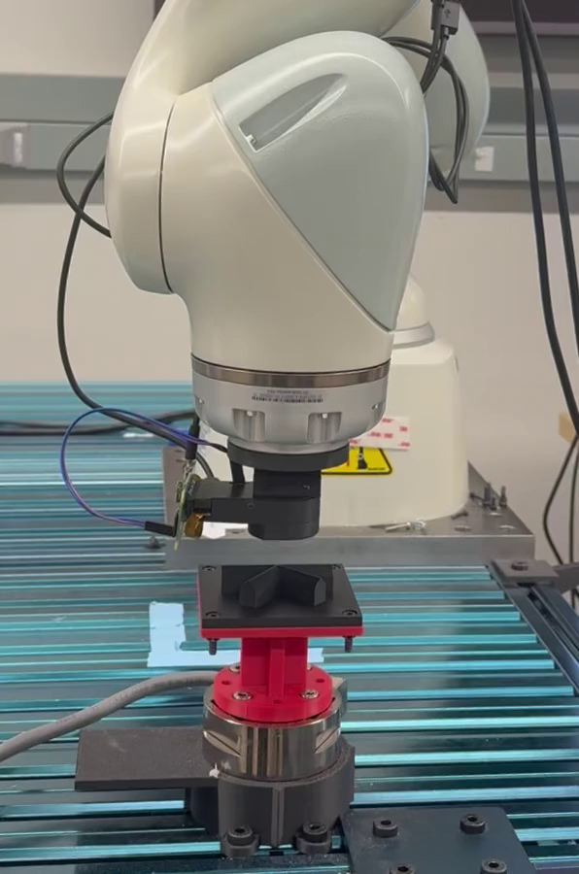
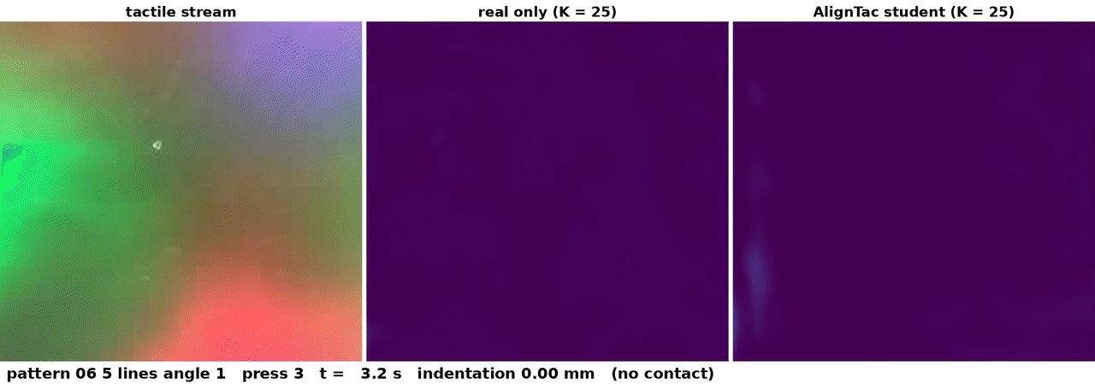
Tactile images are easy to collect; their labels are not
Tactile stream
Depth from real-only (K = 25)
Depth from AlignTac (K = 25)
Each press of the tactile sensor captures a tactile image.
Each label needs the mesh projected at a calibrated, verified robot pose, redone whenever the object is re-placed.
Images are cheap; labels are not.
Left: real data collection (1.5× speed).
Right: tactile stream & contact-depth predictions.
Notes:
14

Slide 3
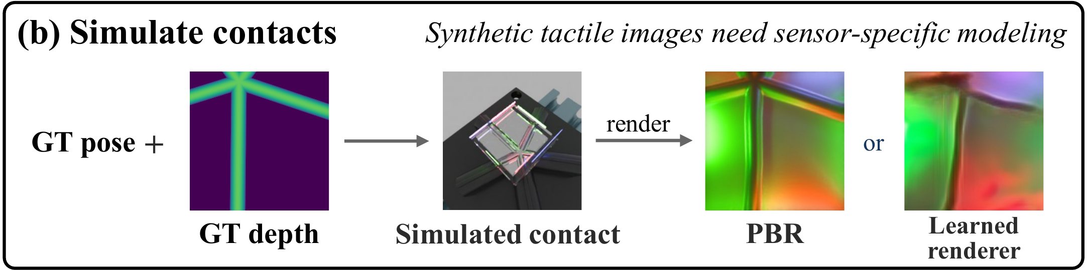
Simulation and self-training each pay a different price
Simulation: requires a sensor-specific renderer, fitted on labeled real pairs
Self-training: labels come from the teacher’s own predictions, errors included
Notes:
12

Slide 4
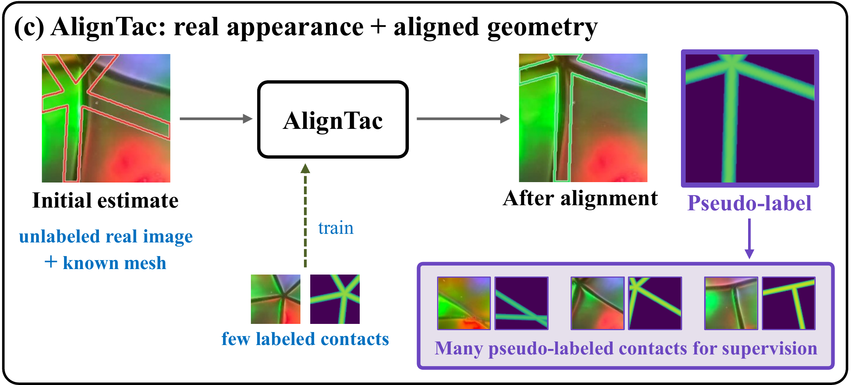
AlignTac: keep real appearance, align known geometry
The real image holds appearance; the known mesh holds the geometry.
AlignTac learns to align the mesh with each real image.
Notes:
14

Slide 5
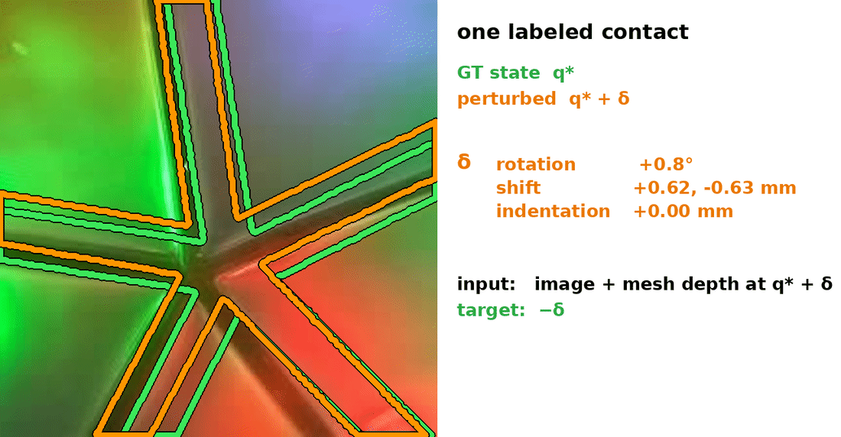
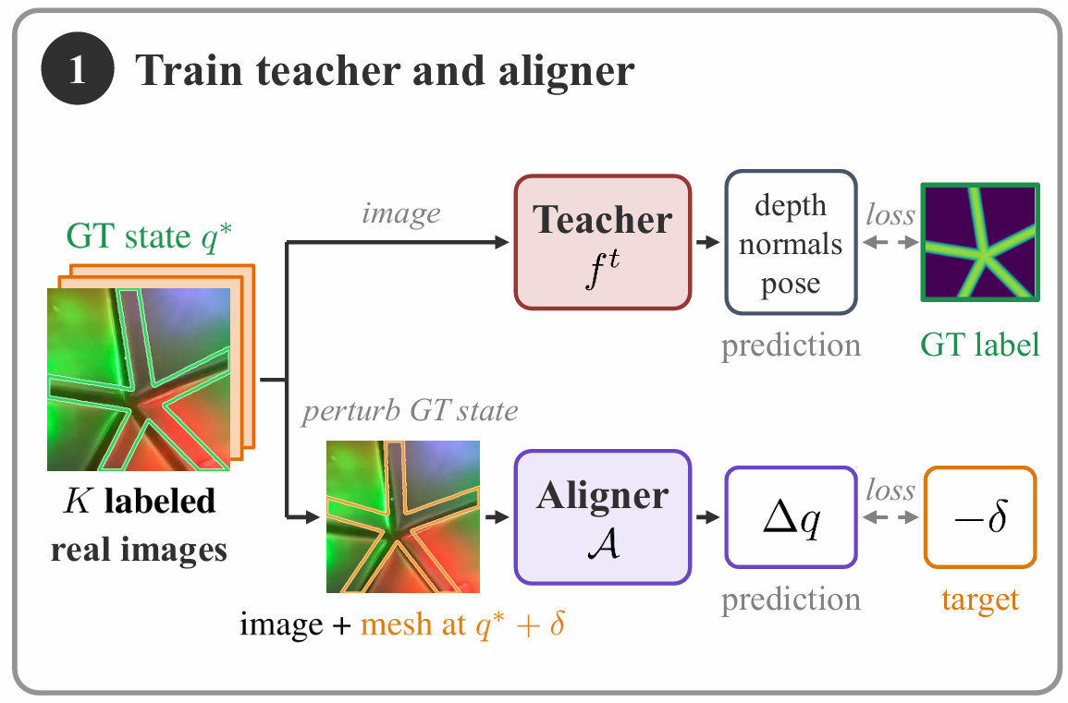
Step 1: a teacher and an aligner from K labeled contacts
Teacher: K labeled contacts → predict depth, normals, pose
Aligner: perturb the known state, project the mesh there, and learn to recover the perturbation
One labeled contact → many training pairs
Aligner: (tactile image, mesh depth at q* + δ) → learn −δ
Notes:
16

Slide 6
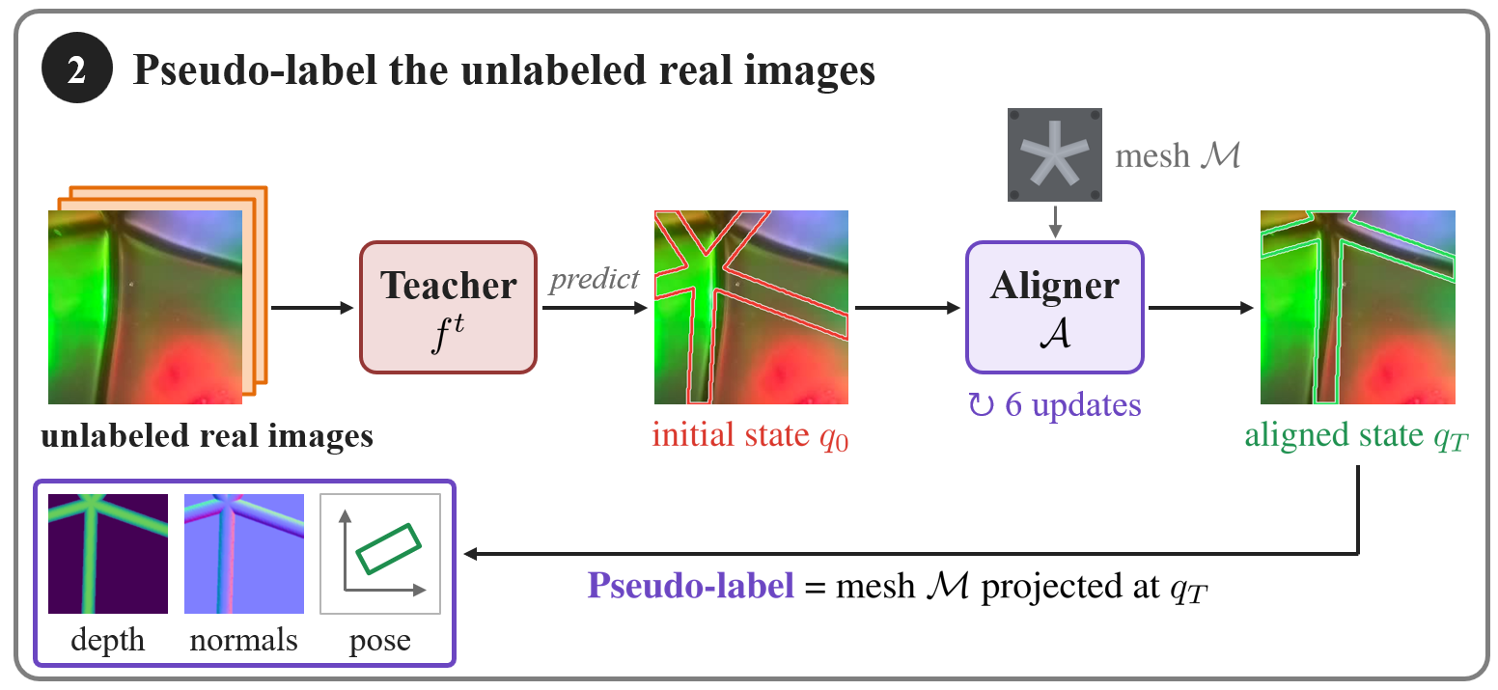
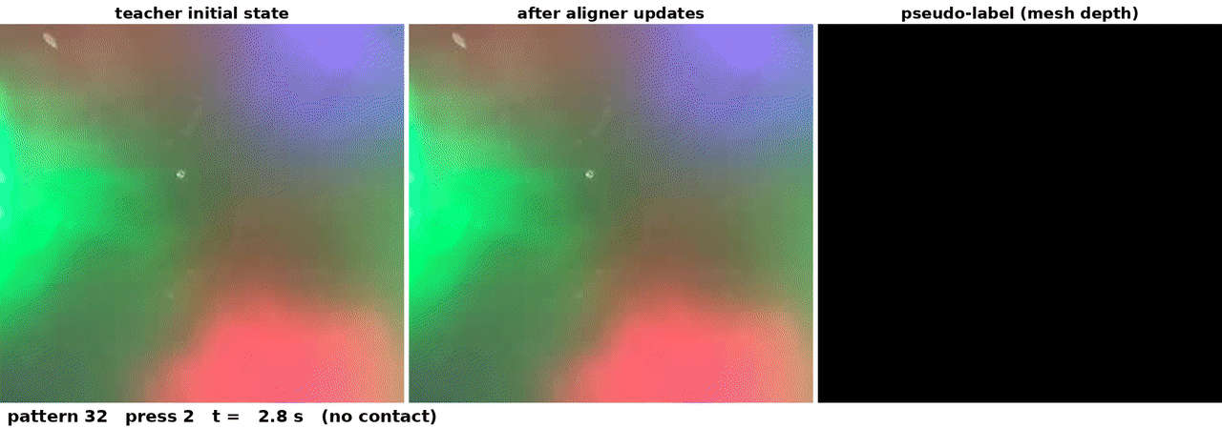
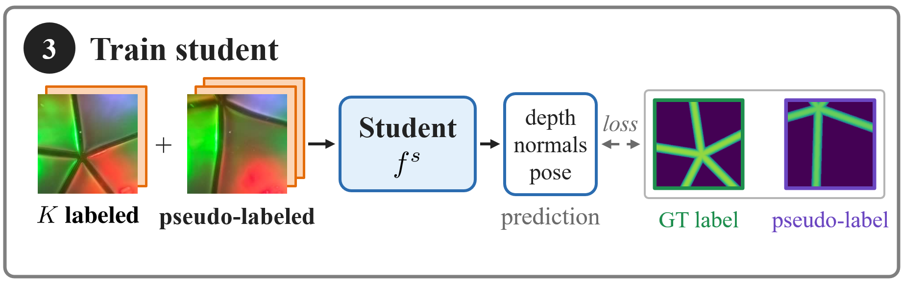
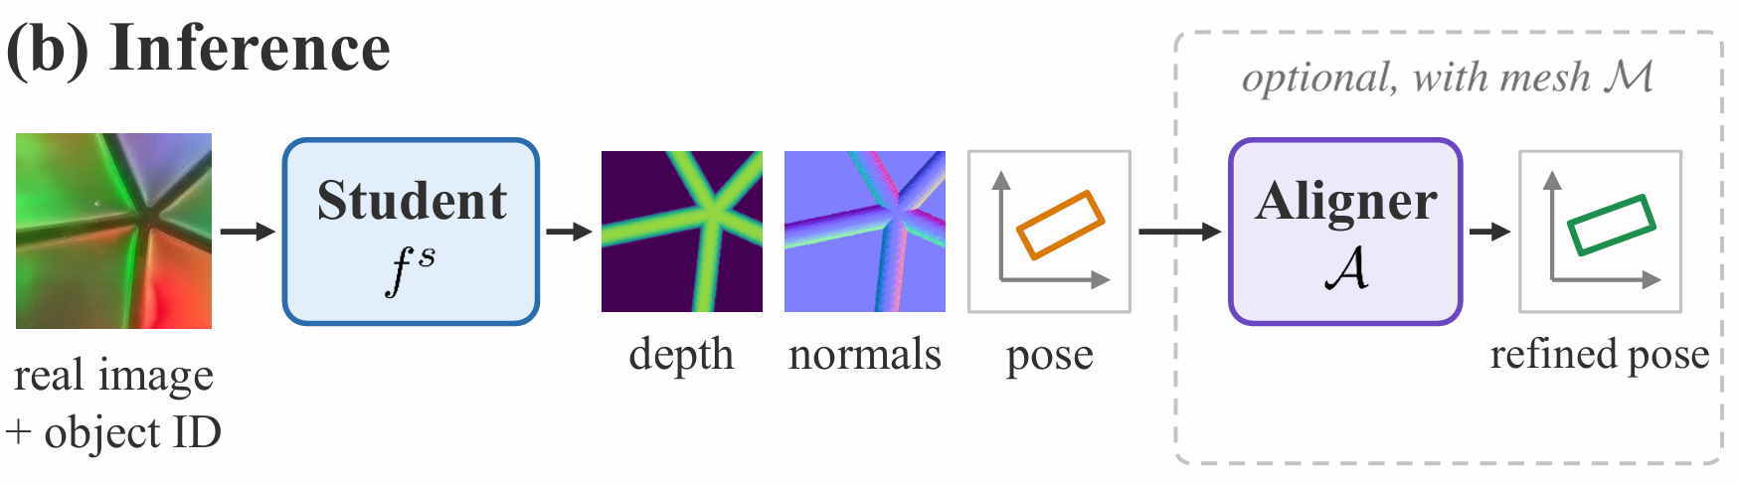
Steps 2 & 3: pseudo-label and training the student
Teacher state
After alignment
Pseudo-label
For each unlabeled image, the teacher gives an initial state and the aligner refines it in six updates.
The mesh at the final state is the pseudo-label.
A student trains on both sets and predicts from the image and object identity alone.
Inference uses only the image and the object identity; mesh-based pose refinement is optional.
Notes:
16

Slide 7
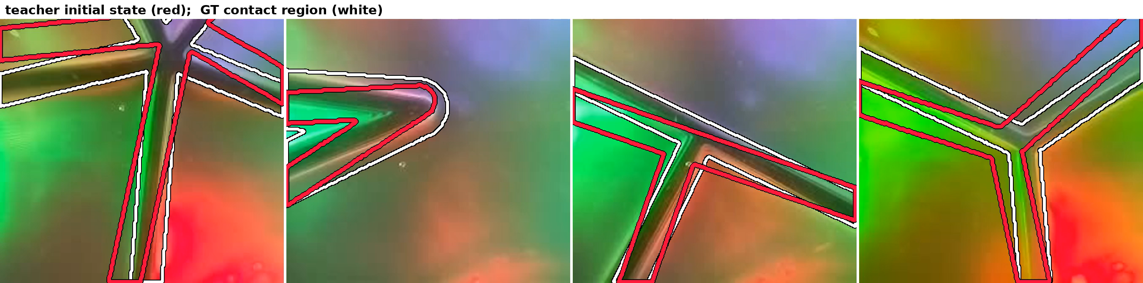
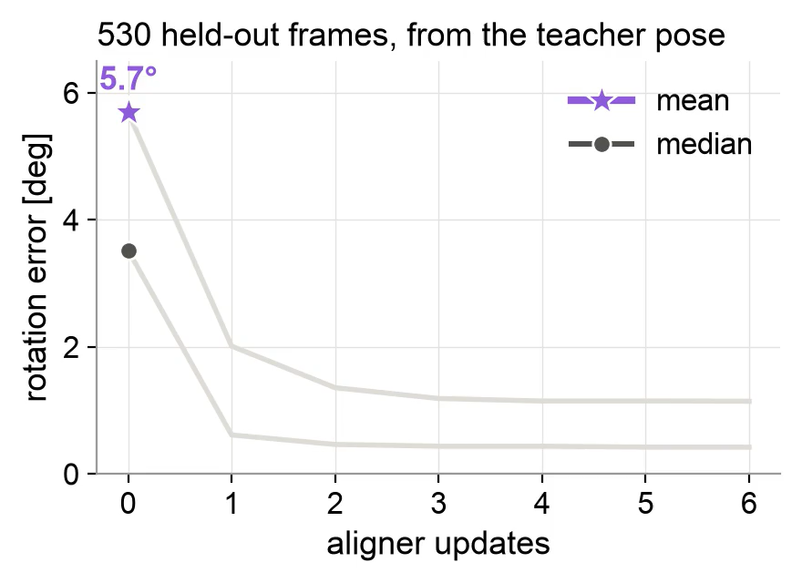
Alignment on held-out real contacts
red: teacher state green: after alignment white: GT contact region
Aligner updates | Rotation (deg) | Translation (mm) | Label IoU | Depth MAE (mm)
n = 0 (teacher state) | 5.7 | 1.09 | 0.48 | 0.39
n = 1 | 2.0 | 0.75 | 0.69 | 0.25
n = 3 | 1.2 | 0.65 | 0.72 | 0.23
n = 6 | 1.1 | 0.65 | 0.73 | 0.23
530 held-out frames (sensor A, K = 25); IoU and depth MAE: mesh at the current state vs. GT.
Notes:
16

Slide 8
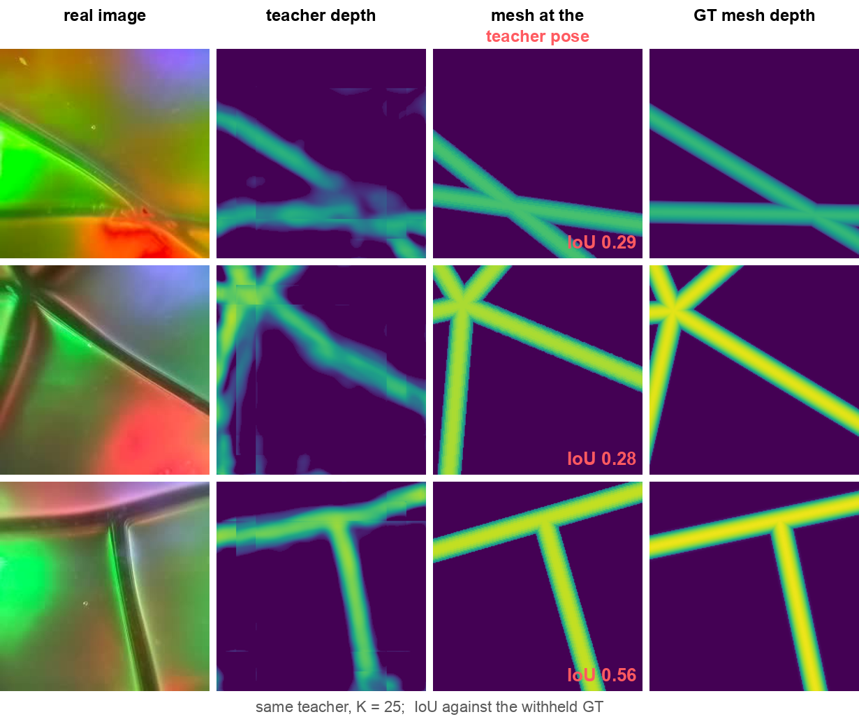
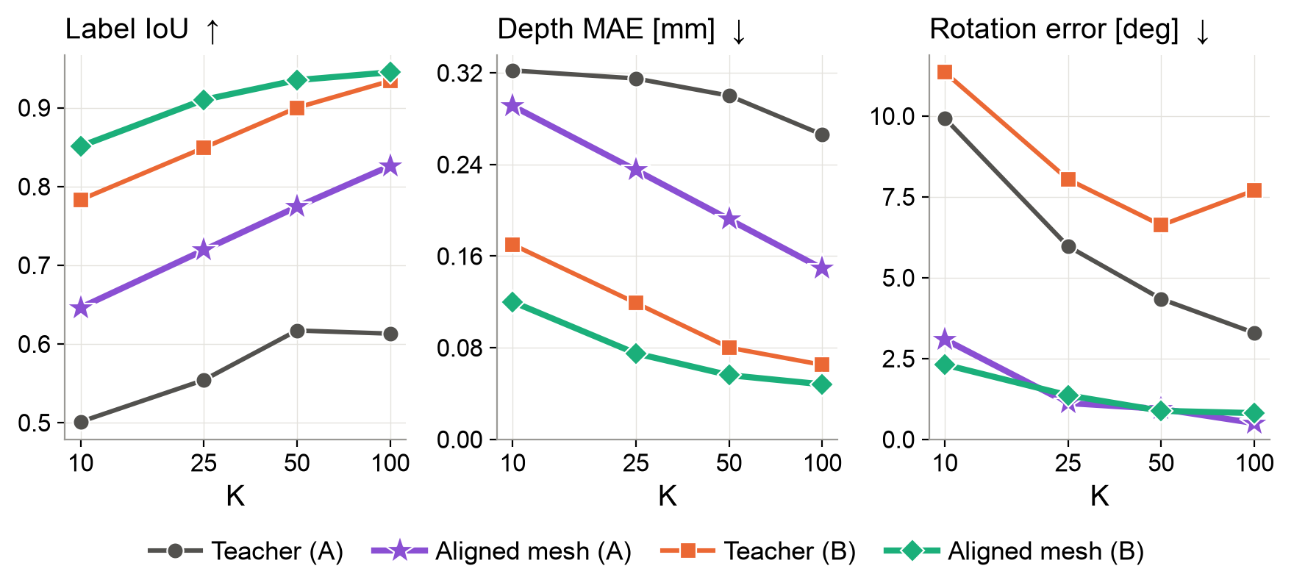
Alignment turns known geometry into accurate labels
Tactile image
Teacher depth
Mesh at
pose
GT depth
Label quality on the unlabeled training images
A: GelSlim 5.0 (marker-free); B: GelSlim 4.0 (dot-marker)
Mesh at | Label IoU | Rotation error
Teacher pose | 0.47 | 6.0°
Aligned pose | 0.72 | 1.1°
Notes:
14

Slide 9
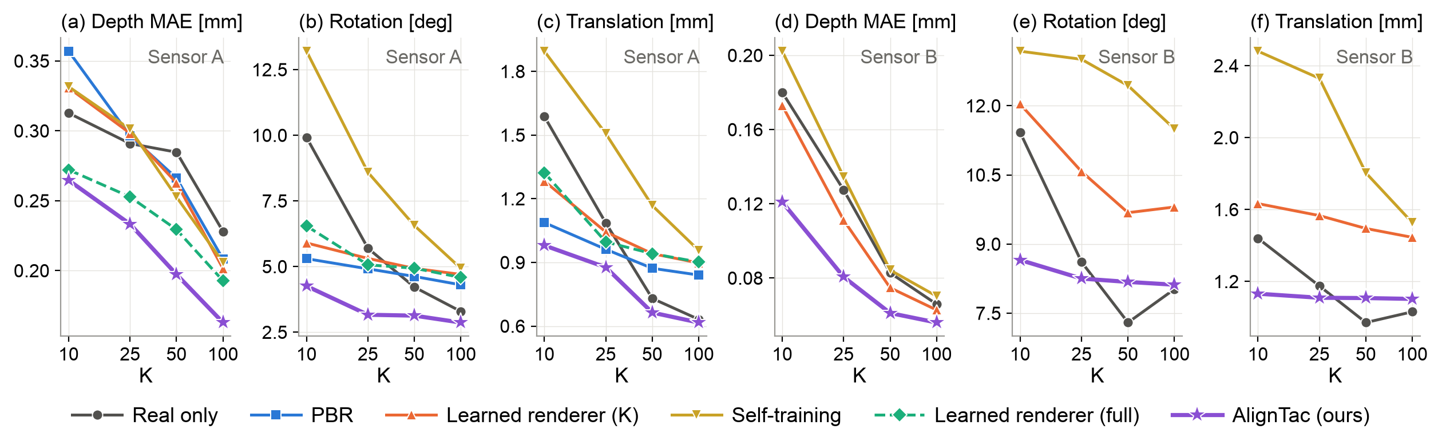
Label efficiency on two GelSlim sensors
Error at K = 25 | Real only | AlignTac | Change
Depth MAE [mm], sensor A | 0.291 | 0.233 | −20%
Rotation [deg], sensor A | 5.7 | 3.2 | −44%
Translation [mm], sensor A | 1.09 | 0.88 | −19%
Depth MAE [mm], sensor B | 0.127 | 0.081 | −36%
Rotation [deg], sensor B | 8.6 | 8.3 | −4%
Translation [mm], sensor B | 1.18 | 1.11 | −6%
Sensor A: GelSlim 5.0 (marker-free)
Sensor B: GelSlim 4.0 (dot-marker)
AlignTac matches real-only accuracy obtained with 2× the labels.
Notes:
14

Slide 10
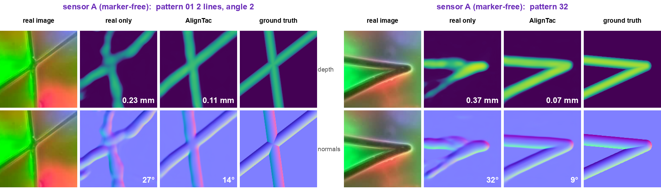
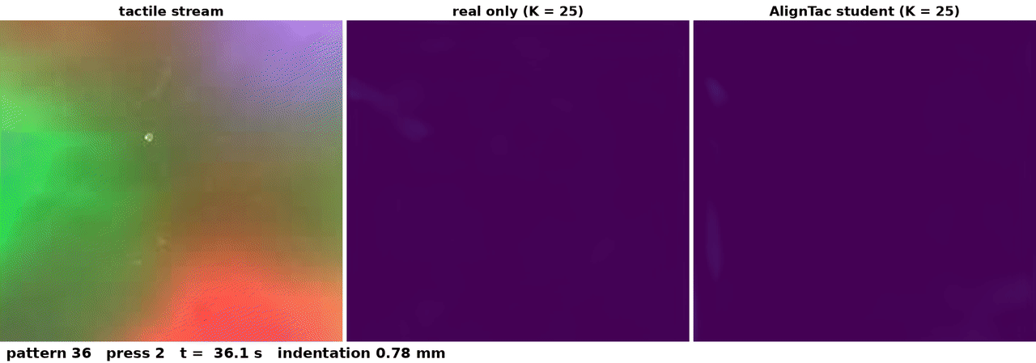
Depth and normals on held-out frames
Image
Real only
AlignTac
GT
Image
Real only
AlignTac
GT
Top video: numbers are depth MAE [mm] and mean normal angle error [deg] over the contact region.
Bottom video: live predictions on a second-session stream.
Notes:
14

Slide 11
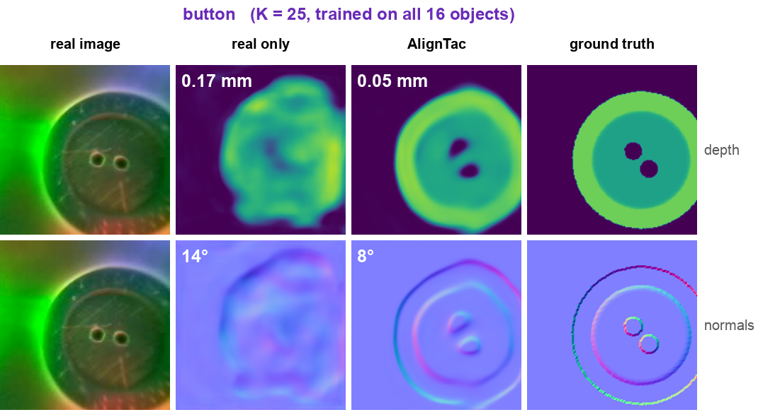
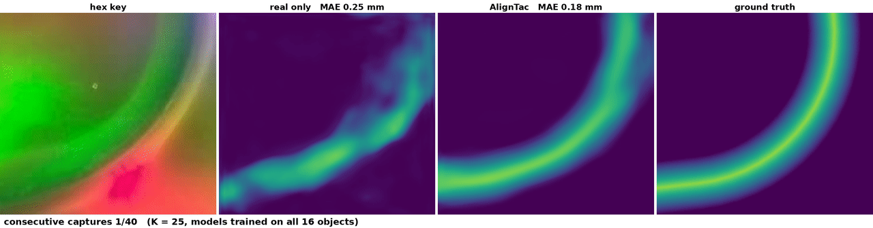
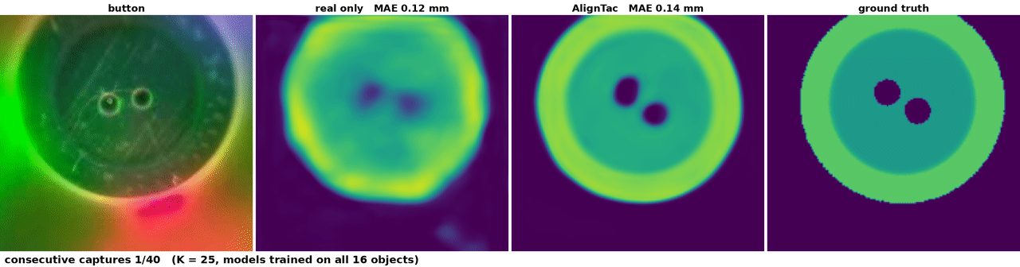
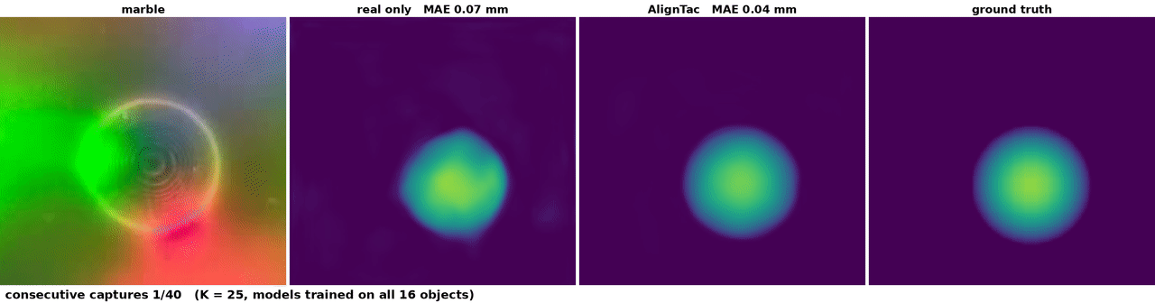
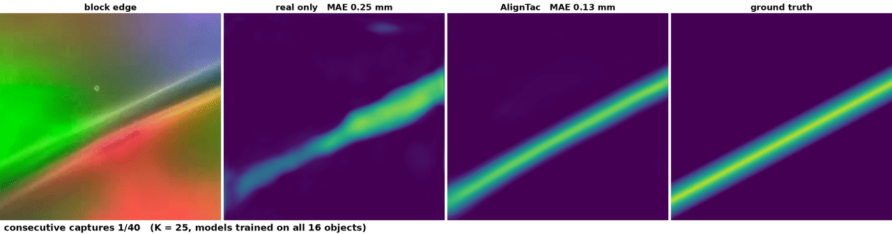
Robust across sessions, sensor variants and objects
Depth MAE [mm] at K = 25 | Real only | AlignTac | Change
Session 2, zero-shot | 0.344 | 0.295 | −14%
Session 2, label-free adaptation | 0.341 | 0.280 | −18%
Sensor B, dot-marker variant | 0.127 | 0.081 | −36%
Four additional objects | 0.235 | 0.204 | −13%
Label-free adaptation: AlignTac also pseudo-labels the unlabeled session-2 images.
Notes:
16

Slide 12
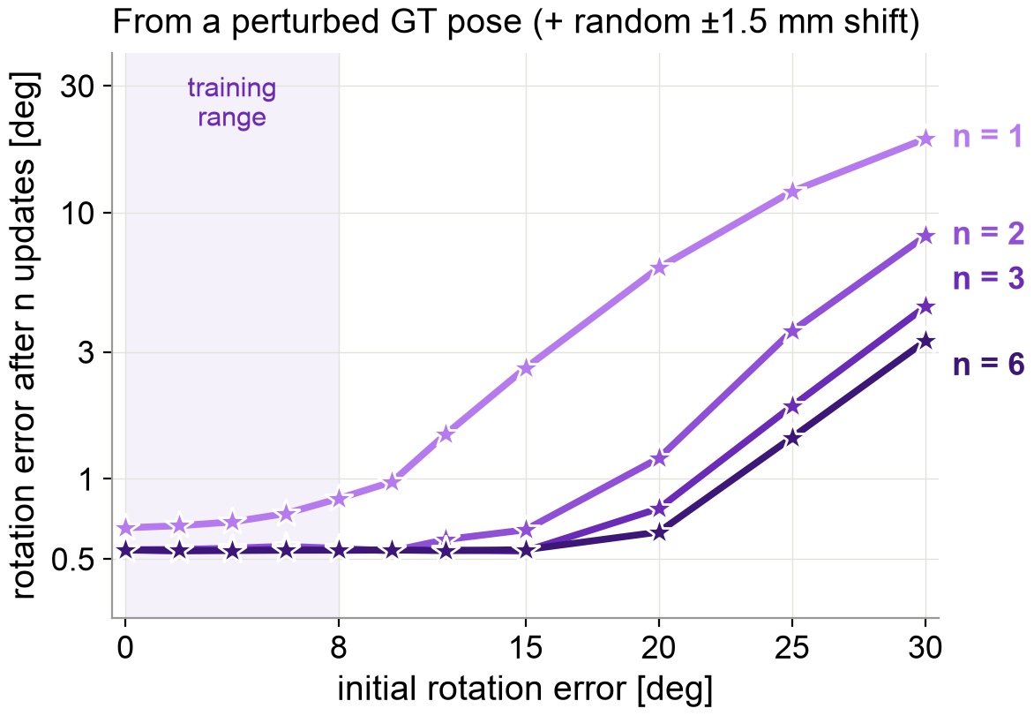
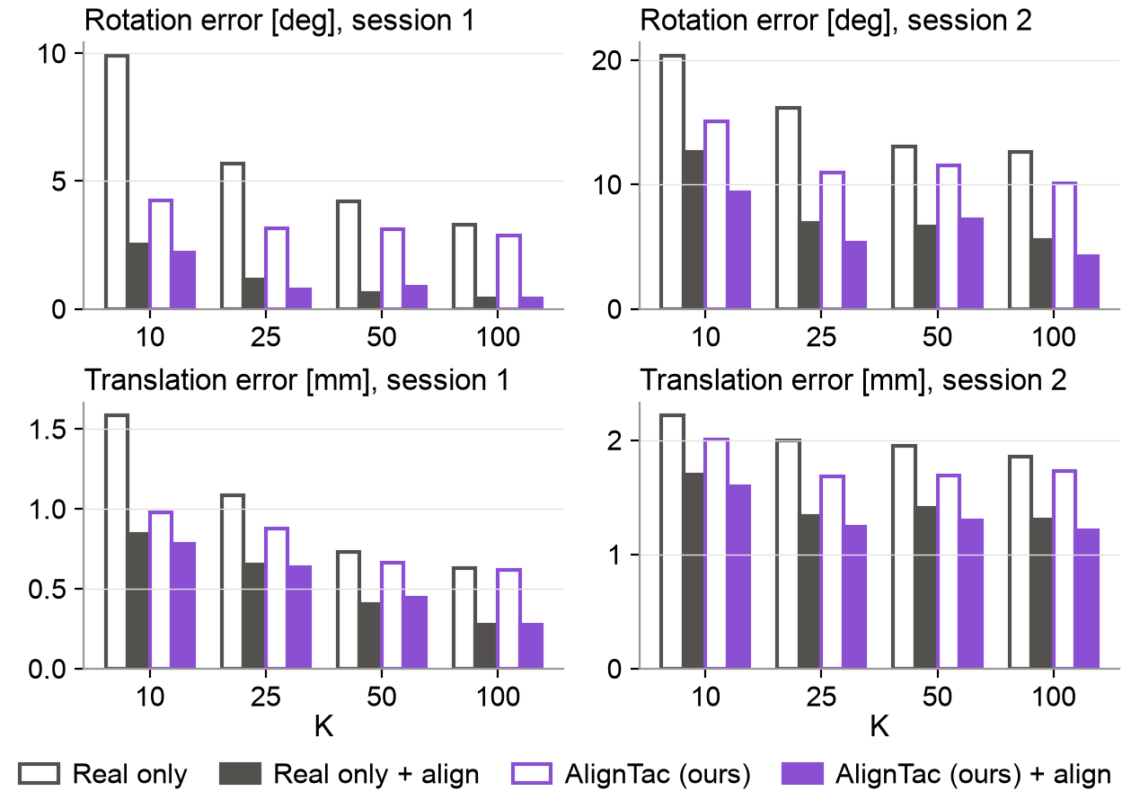
The aligner also refines pose at inference
Left: from a rotated GT pose, n updates bring the error below 1° up to 15°, twice the training range
Right: each predictor's own pose refined at inference (hollow → filled), session 1 and session 2
Notes:
12

Slide 13
Takeaways
• Real images supply appearance; the known mesh supplies geometry; AlignTac learns the contact state that connects them
• K = 25 labeled contacts per object: depth MAE −20% / −36% on two GelSlim sensors, matching real-only training with 2× the labels
• Alignment, not geometry alone, makes the labels accurate (label IoU 0.47 → 0.72 with the same teacher)
• The same aligner pseudo-labels a new session without re-calibration and refines pose at inference
• Code will be released
Notes:
12

